Slide 1
LeakWatch
Machine Learning for Water-Leak Detection, Localization and Response
Midterm Progress Presentation
CH Sri Ravali | MS Data Science | B00120507
Notes:
Greet the professor and introduce yourself. Say: My project is LeakWatch - it uses machine learning to detect water leaks, find their area, and send the nearest crew. Today I will explain what I have built so far and what I will do next.

Slide 2
OUTLINE
What this presentation covers
1
Introduction
what LeakWatch is, why it matters, and how it works
2
Methodology
how I approached the problem, step by step
3
What I have done
the data, the feature, the model, and the results
4
Results
detection accuracy and the model comparison
5
What is next
the remaining steps to finish the project
LeakWatch - Midterm Progress
2
Notes:
This is my roadmap. Say: first I will introduce the project - what it is, why it matters, and how it works. Then my methodology, then what I have done - the data, the feature, the model and the results, then the results in detail, and finally what is left to do.

Slide 3
INTRODUCTION - 1 OF 3
What is LeakWatch?
LeakWatch is a machine-learning system that finds water leaks in a city's pipe network.
It works from water-pressure sensors: when a pipe leaks, water escapes and the pressure nearby drops - that drop is the clue the system looks for.
From those pressure readings it does three things: find out IF there is a leak, WHERE (which area) it is, and WHO should be sent to fix it.
The aim is to catch leaks early and automatically, instead of waiting for water to surface on the street.
In one line: sensor readings go in -> "there is a leak, it is near here, send this crew" comes out.
LeakWatch - Midterm Progress
3
Notes:
“LeakWatch is a machine-learning system for detecting water leaks. The whole thing is built on one piece of physics: when a pipe springs a leak, water escapes, and the pressure in the pipes nearby falls. So a pressure drop is like a fingerprint of a leak. My system reads pressure from a few sensors and does three things — it detects whether there’s a leak, it localizes which area the leak is in, and it responds by finding the nearest repair crew and route. The goal is to catch leaks early and automatically, instead of waiting weeks for water to show up on the street.”

Slide 4
INTRODUCTION - 2 OF 3
Why this project matters
Water utilities lose an estimated 30-50% of their clean, treated water to leaks in underground pipes.
These leaks are invisible - no one sees them until water finally reaches the surface, often weeks or months later.
That wasted water also wastes the energy and money used to clean and pump it.
Traditional leak-finding is slow and manual. Machine learning can flag a leak from sensor data as soon as the pressure pattern changes.
So the problem I am solving: detect and locate leaks earlier, using only a few sensors, so repairs happen faster.
LeakWatch - Midterm Progress
4
Notes:
“This matters because the numbers are huge. Water utilities lose somewhere between 30 and 50 percent of their clean, treated water to leaks in underground pipes. These leaks are invisible — nobody sees them until water finally surfaces, which can take weeks or even months. And it’s not just water being wasted; it’s all the energy and money spent cleaning and pumping that water too. Right now, finding leaks is slow and manual. Machine learning can flag a leak the moment the pressure pattern changes. So the problem I’m solving is detecting and locating leaks earlier, using just a few sensors, so repairs can happen faster.”

Slide 5
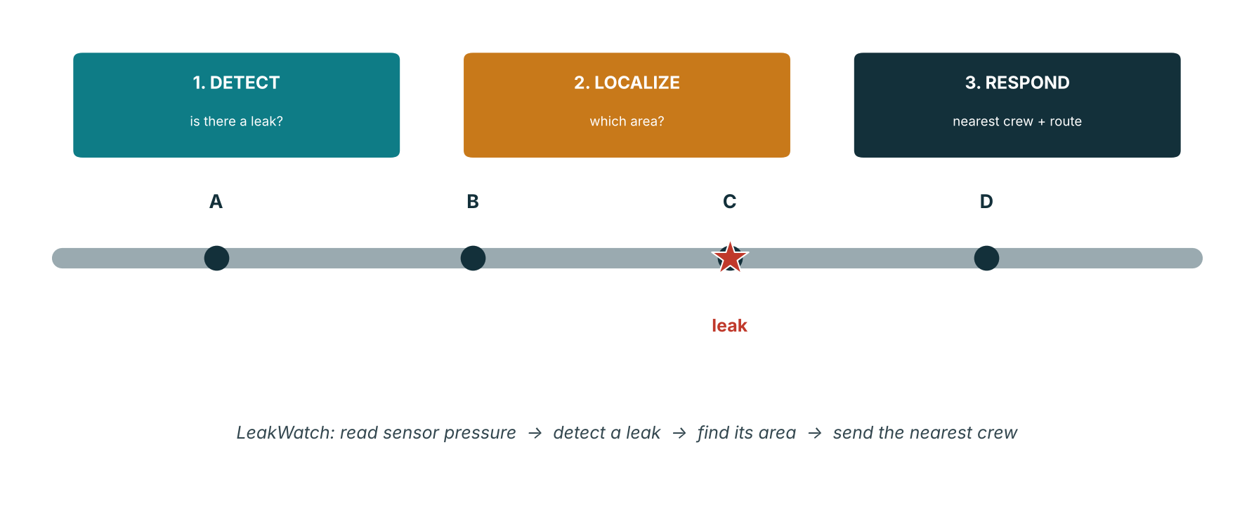
INTRODUCTION - 3 OF 3
How the system works: three steps
1. DETECT - a machine-learning model reads the sensor pressure drops and decides: leak or no leak.
2. LOCALIZE - a model works out which AREA of the network the leak is in.
3. RESPOND - the system finds the nearest repair crew and the shortest route (a calculation, not ML).
This midterm covers the DETECTION step and a model comparison, which are built and tested. Localization and response are next.
LeakWatch - Midterm Progress
5
Notes:
“My system works in three steps. First, DETECT — a machine-learning model reads the pressure drops from the sensors and decides: is there a leak, yes or no. Second, LOCALIZE — a model figures out which area of the network the leak is in. Third, RESPOND — the system finds the nearest repair crew and the shortest route to send them, and that step is a plain calculation, not machine learning. I’ve built and tested the detection step and a model comparison. Localization and the response step are my next steps.”

Slide 6
SETUP
Tools I use
EPANET + WNTR
the water simulator (EPANET) and its Python interface (WNTR) - they model water physics
Net3 network
the standard example water network (92 junctions, 117 pipes) from the US EPA
scikit-learn
the machine-learning library - provides my Random Forest and the other models
pandas / numpy
build the data table and add realistic noise
matplotlib
draws the charts and figures
Colab + GitHub
where I write, run, and store the project
LeakWatch - Midterm Progress
6
Notes:
“These are the tools I used. EPANET is a water simulator made by the US EPA — it knows the physics of water in pipes. WNTR is the Python tool that runs EPANET from my code. Net3 is the standard example network I run on. Scikit-learn is the machine-learning library that gives me my model. Pandas and NumPy build my data table and add realistic noise. Matplotlib draws my charts. And I write and run everything in Google Colab, storing it on GitHub.”

Slide 7
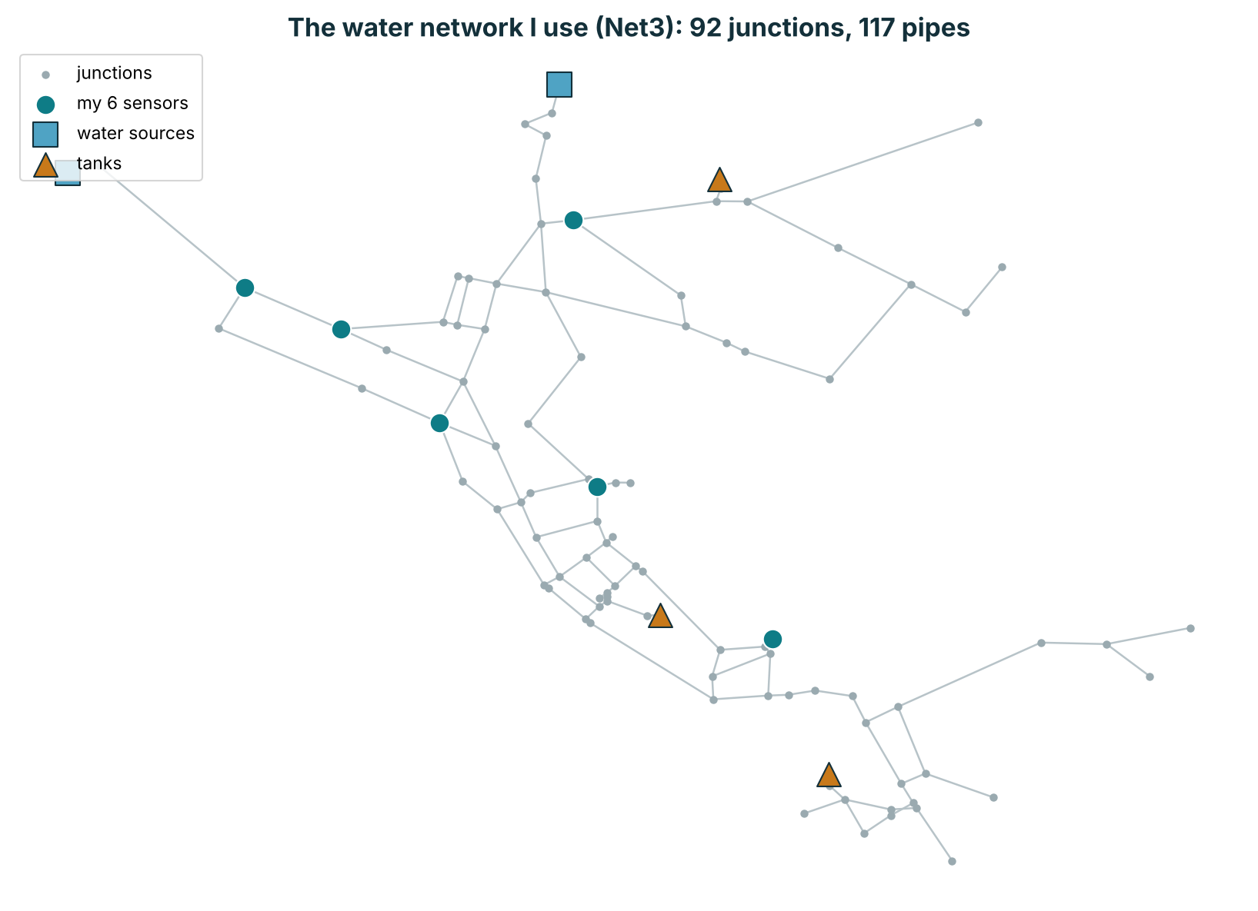
THE DATA SOURCE
The water network (Net3)
Net3: a standard example network from the US EPA, built into WNTR - I did not create it.
92 junctions, 117 pipes, with water sources (blue) and tanks (amber).
The 6 teal dots are my sensors - I read pressure only there (utilities use few sensors).
Catching a leak in 117 pipes from only 6 sensors is what makes this a real ML problem.
LeakWatch - Midterm Progress
7
Notes:
“This is the water network my project runs on. It’s called Net3 — a standard example network from the US EPA, built right into the WNTR tool. I did not create it; it’s a recognized benchmark, which makes my work credible. It has 92 junctions and 117 pipes. The teal dots you see are my six sensors — those are the only places I read pressure from. And this is actually the heart of the challenge: I’m trying to catch a leak anywhere across 117 pipes using just six sensors. That’s what makes it a real machine-learning problem and not something trivial.”

Slide 8
MY APPROACH
Methodology
1
Generate data
simulate the network and place leaks to build labelled examples
2
Engineer a feature
turn raw pressure into the 'drop from normal' at each sensor
3
Train a model
train a Random Forest to detect a leak from the drops
4
Evaluate & compare
test on unseen leaks and compare against other models
LeakWatch - Midterm Progress
8
Notes:
“My approach has four steps. First, I generate my own data by simulating the network and placing leaks. Second, I engineer a feature — I turn the raw pressure into a smarter input called the drop from normal. Third, I train a Random Forest model to detect a leak from those drops. And fourth, I evaluate it on unseen leaks and compare it against other models. The next few slides show each of these steps.”

Slide 9
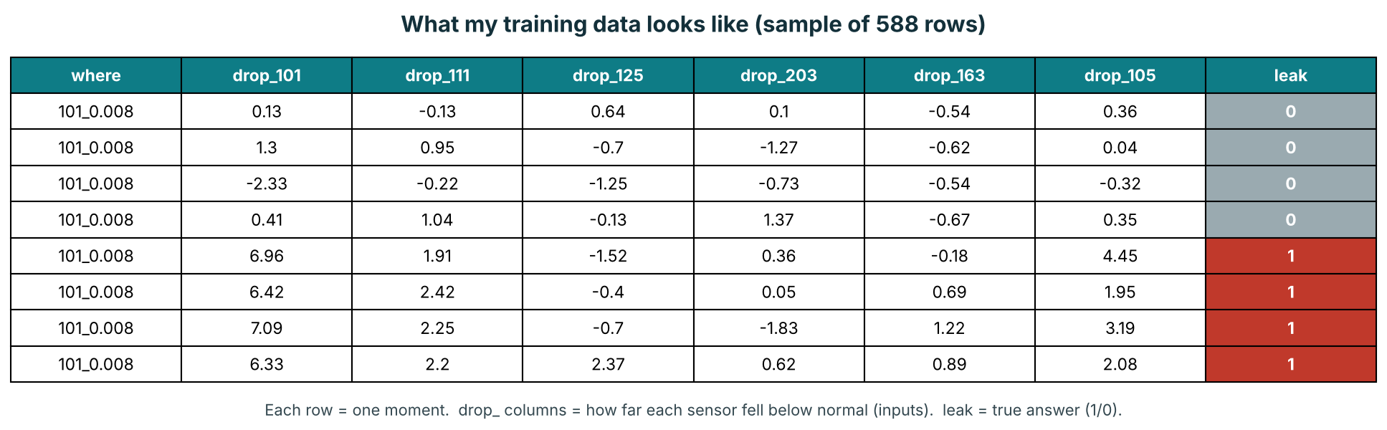
WHAT I DID
Dataset: 588 labelled rows
Generated by simulation - I place each leak, so every row has a known true label.
Inputs = the sensor 'drop' columns; label = leak (1) or no-leak (0).
No-leak rows have small drops; leak rows have big drops - the pattern the model learns.
LeakWatch - Midterm Progress
9
Notes:
“This is my training data. Since there’s no free public dataset of real labeled leaks, I generate my own with the simulator. Each row here is one moment in time at my six sensors. The ‘drop’ columns are the inputs to my model, and the last column, ‘leak’, is the true answer — 1 for leak, 0 for no leak. You can see the pattern right in the table: the grey rows, which are no-leak, have small drops near zero, and the red rows, which are leaks, have big drops. In total I have 588 labeled rows. The key point is that because I place every leak myself, I always know the true answer — and that’s exactly what lets me train the model and measure how accurate it is. To be honest, this is simulated data, not real hardware — but that’s standard in this field, and later I plan to validate on a real dataset.”

Slide 10
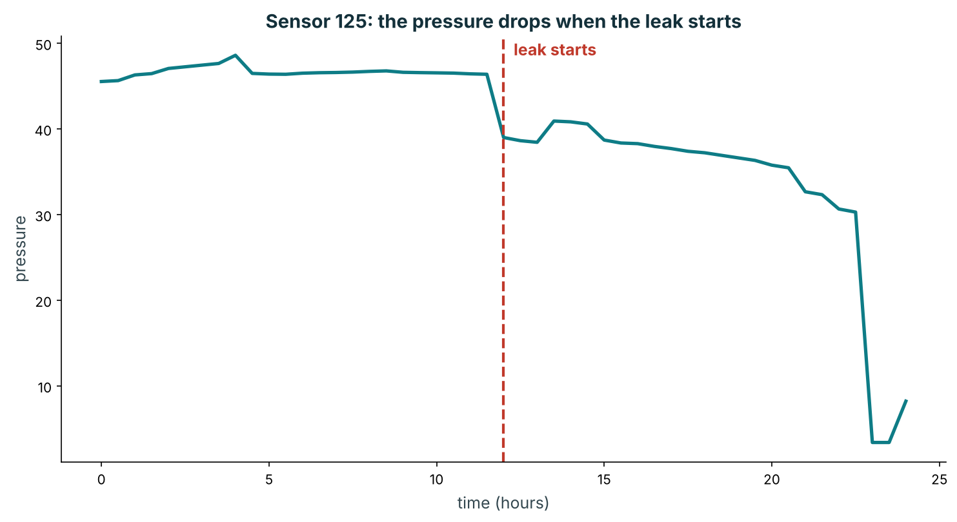
WHAT I DID
Feature engineering: the 'drop from normal'
drop = normal pressure − actual reading (+ a little noise)
Problem: raw pressure rises and falls all day with water use, so a leak hides in it.
My fix: for each sensor I subtract the actual reading from its normal level - the 'drop'.
Why it works: this cancels the daily pattern, so only a real leak shows a big drop.
Small drop = no leak; big drop = leak - a clear signal the model can learn.
I add a little sensor noise for realism (avoids a fake 100%). This is 'feature engineering'.
Chart: pressure is steady before the leak, then clearly drops after it starts at hour 12.
LeakWatch - Midterm Progress
10
Notes:
This is the clever part of my project. If I just fed the model raw pressure, a leak would be hard to spot, because pressure naturally rises and falls all day as people use water — the leak hides inside that daily movement. So instead I engineer a feature called the drop from normal. For each sensor, I take what the pressure should be when everything’s healthy, and I subtract the actual reading — that difference is the drop. Because I’m comparing each reading to what’s normal at that same time, the daily pattern cancels out, and only a real leak stands out as a big drop. So small drops mean no leak, and big drops mean a leak. This chart proves it: the pressure is steady before the leak starts at hour 12, then it clearly drops after. Turning raw data into a smarter input like this is called feature engineering, and it’s a big reason my model works so well.”

Slide 11
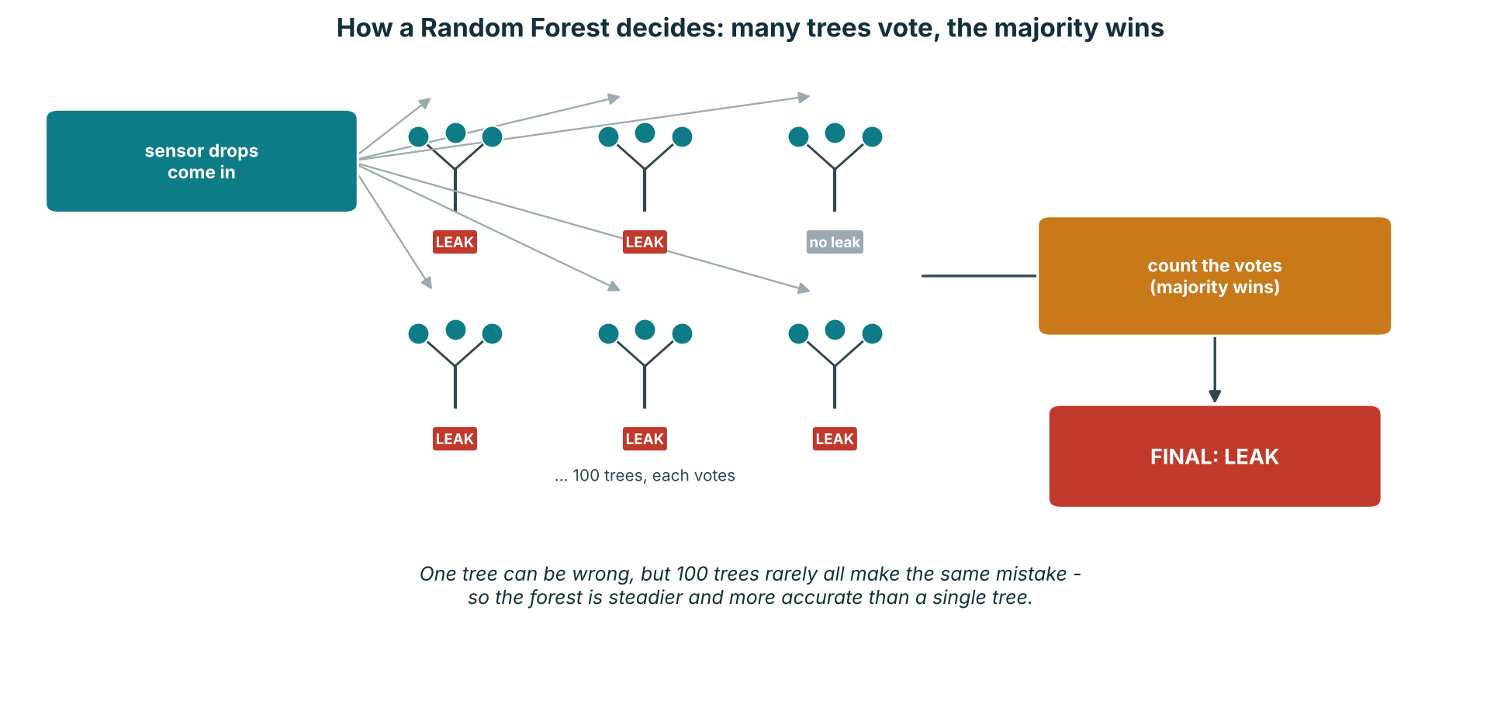
WHAT I DID
Model: Random Forest
A Random Forest builds many decision trees, each on a random slice of the data; they vote.
The majority vote wins, so a single tree's mistake is outvoted - making it reliable and robust to noise.
LeakWatch - Midterm Progress
11
Notes:
“My model is a Random Forest. A Random Forest is made of many decision trees — about a hundred — and each one is trained on a slightly different random slice of the data. When a new reading comes in, every tree votes ‘leak’ or ‘no leak,’ and the majority wins. The reason this works so well is that any single tree can make a silly mistake, but a hundred trees rarely all make the same mistake, so their errors cancel out. That makes the forest much steadier and more accurate than one tree, and robust to noisy sensor readings. That’s why I chose it for my project.”

Slide 12
WHAT I DID - RESULT
Detection accuracy
98%
correct on leaks it never saw
Measured on leaks the model never trained on - testing on unseen leaks makes the number trustworthy.
The few misses are the smallest leaks, which make the faintest pressure drops.
Not a fake 100% - sensor noise keeps the result realistic.
LeakWatch - Midterm Progress
12
Notes:
“Here’s my main result: my detection model is about 98 percent accurate. And importantly, that’s measured on leaks the model never saw during training — I test on unseen leaks, because testing on data it already learned would be cheating and wouldn’t be honest. The few mistakes it makes are on the very smallest leaks, which make the faintest pressure drops and are naturally the hardest to catch. And this isn’t a fake, suspicious 100 percent — because I add a little sensor noise to make the data realistic, so 98 percent is an honest number.”

Slide 13
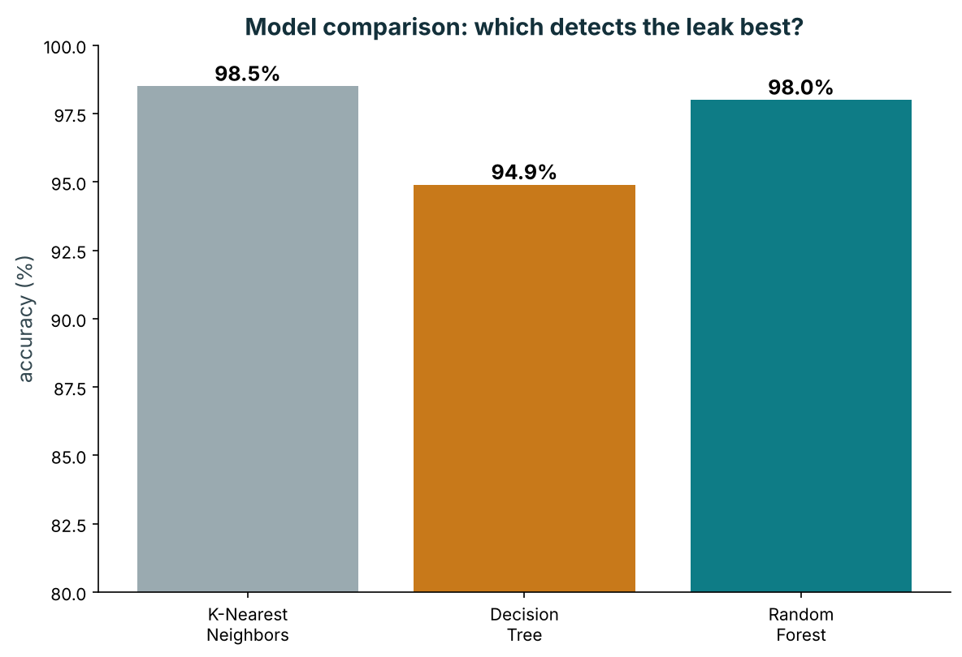
WHAT I DID - RESULT
Model comparison: why Random Forest
Compared Random Forest with KNN and a Decision Tree on identical data.
KNN 98.5%, Decision Tree 94.9%, Random Forest 98.0% - all high, basically tied.
This shows detection is the easy part.
I keep Random Forest for its reliability on the harder localization step and with noise.
LeakWatch - Midterm Progress
13
Notes:
“You asked me to justify why I chose Random Forest, so I ran a fair comparison. I took the same data and the same test, and I compared Random Forest against two other models — K-Nearest Neighbors and a single Decision Tree. K-Nearest Neighbors scored 98.5 percent, the Decision Tree 94.9, and Random Forest 98.0. What’s interesting is they’re all high and basically tied — and that actually tells me something important: detection is the easy part of the problem, so the score alone can’t decide my model. I keep Random Forest because it’s the one that stays most reliable on the harder localization step and with noisy data, and it even shows me which sensors mattered most. So I’m choosing it for the whole pipeline, not just this one easy step.”
“For localization — finding which area the leak is in — I’ll use the same Random Forest. And it’ll actually work better there than the other models, for a clear reason. Detection is a simple yes/no question, so every model handled it easily. But localization is harder — it’s a multiple-choice question: which area? That’s where a straight-line model like KNN or a single Decision Tree gets weaker, because the areas aren’t cleanly separable. Random Forest handles that kind of harder, multi-choice problem well, because it combines a hundred trees that vote, so it stays steady where the simpler models wobble. That’s the real reason I keep Random Forest across the whole project — not because it won on detection, but because it’s the one that holds up on the harder localization step.”

Slide 14
SUMMARY
What I have done so far
Set up the environment and loaded the Net3 network
DONE
Generated my own labelled leak dataset by simulation (588 rows)
DONE
Engineered the 'drop from normal' feature
DONE
Trained the Random Forest detection model
DONE
Measured detection accuracy (~98% on unseen leaks)
DONE
Compared models (KNN, Decision Tree, Random Forest) to justify Random Forest
DONE
LeakWatch - Midterm Progress
14
Notes:
“To summarize what’s complete and running in my notebook: I set up the environment and network, I generated my own labeled dataset of 588 rows, I engineered the drop feature, I trained the Random Forest detection model, I measured its accuracy at about 98 percent, and I did the model comparison to justify my choice. So the detection part of my project is fully built and tested.”

Slide 15
WHAT IS LEFT
What I have to do next
Build the localization model - find WHICH AREA the leak is in (e.g. West / East)
1
Add the response step - nearest crew and shortest route (a calculation, not ML)
2
Integrate detect -> localize -> respond into one pipeline
3
Validate the method on a real public dataset to confirm it works beyond simulation
4
Write the final report with clean code and documentation
5
LeakWatch - Midterm Progress
15
Notes:
“Here’s what I still have to do. First, build the localization model to find which area the leak is in. Second, add the response step that finds the nearest crew and route. Third, combine detect, localize, and respond into one smooth pipeline. Fourth, validate my method on a real public dataset, to prove it works beyond my own simulation. And finally, write up the final report with clean code and documentation.”

Slide 16
CONCLUSION
Summary
LeakWatch detects water leaks from a few pressure sensors using machine learning.
Done so far: a simulated labelled dataset, the 'drop' feature, and a Random Forest detecting leaks at ~98%, justified by a model comparison.
Still to do: localization, response routing, real-data validation, and the final write-up.
Detect -> Localize -> Respond | Detection is built and validated; the rest is in progress.
LeakWatch - Midterm Progress
16
Notes:
“To conclude: LeakWatch detects water leaks from just a few pressure sensors using machine learning. So far I’ve built the data, engineered the drop feature, and trained a Random Forest that detects leaks at about 98 percent, and I justified that choice with a model comparison. What’s left is localization, the response step, validating on real data, and the write-up. The whole idea in three words is detect, localize, respond — and the detection part is built and validated, with the rest in progress. Thank you — I’m happy to take any questions.”

